Slide 1
Georgia Pacific
Xin XIONG

Slide 2
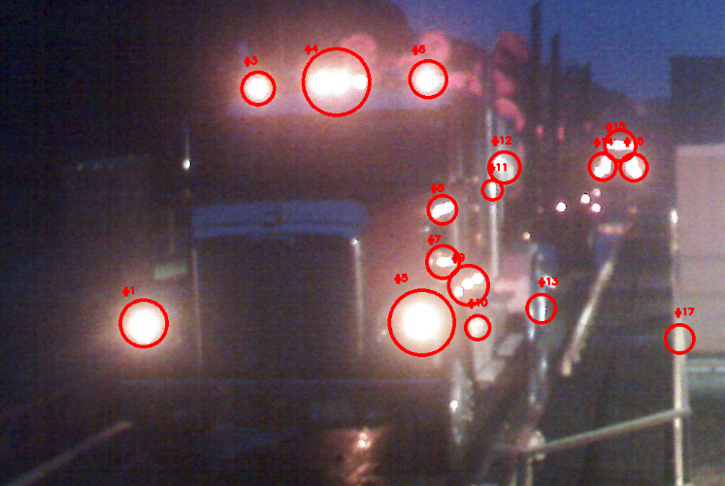
Contours – Determining the Radius of the Contours

Slide 3
Image – Feature Mapping
Brute-Force Matching with ORB Descriptors
Brute-Force Matching with SIFT Descriptors and Ratio Test
FLANN based Matcher

Slide 4
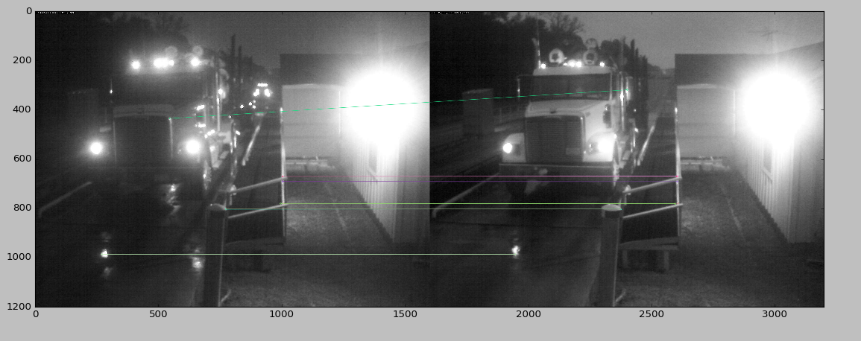
Brute-Force Matching with ORB Descriptors

Slide 5
ORB descriptor -Oriented FAST and Rotated BRIEF
ORB is basically a fusion of FAST key point detector and BRIEF descriptor with many modifications to enhance the performance. First it use FAST to find key points, then apply Harris corner measure to find top N points among them. It also use pyramid to produce multiscale-features

Slide 6
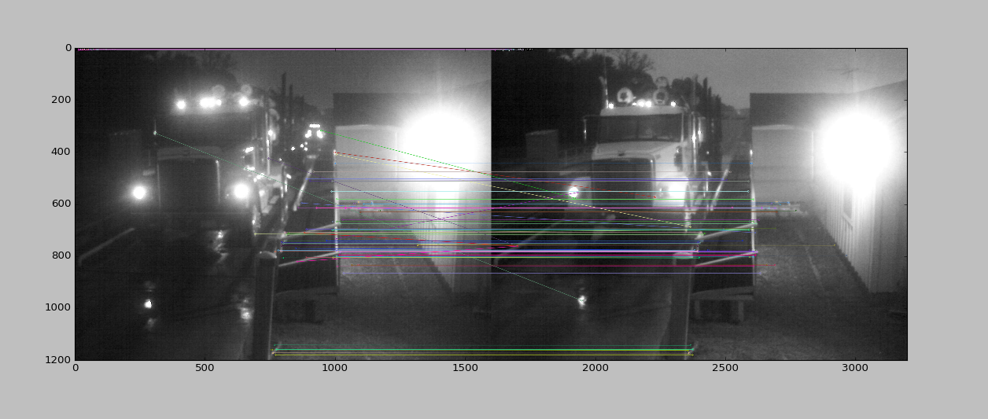
Brute-Force Matching with SIFT Descriptors and Ratio Test

Slide 7
SIFT Descriptors and Ratio Test
Scale-invariant feature transform (SIFT) is an algorithm in computer vision to detect and describe local features in images
BFMatcher.knnMatch() to get k best matches
SIFT keypoints of objects are first extracted from a set of reference images^{[2]} and stored in a database. An object is recognized in a new image by individually comparing each feature from the new image to this database and finding candidate matching features based on Euclidean distance of their feature vectors. From the full set of matches, subsets of keypoints that agree on the object and its location, scale, and orientation in the new image are identified to filter out good matches.

Slide 8
Ratio test
You could then use this distance to compute the best match between a feature in one image
and the set of features in another image by finding the one with the smallest distance.
Two possible distances are:
1. use a threshold on the match score. This is called the SSD distance,
and is implemented for you as match type 1, in the function sshMatchFeatures.
2. compute (score of the best feature match)/(score of the second best feature match).
This is called the "ratio test"; you must implement this distance.

Slide 9
FLANN based Matcher
FLANN stands for Fast Library for Approximate Nearest Neighbors. It contains a collection of algorithms optimized for fast nearest neighbor search in large datasets and for high dimensional features. It works more faster than BFMatcher for large datasets.

Slide 10
Thank you

